Slide 1

Welcome to the
Tickle College of Engineering(TCE)!
It’s time to take the next step in your journey toward becoming an engineer, and we are happy that you have chosen to take it with us at the University of Tennessee, Knoxville.

Slide 2
Goals of this Powerpoint
Acquaint yourself with the Tickle College of Engineering
Understand basic requirements of our college and how to get involved at UT
Familiarize yourself with degree requirements and frequently used terminology
Complete the worksheets and modules to prepare
for orientation advising
Devise a tentative schedule (this will be approved and possibly refined during orientation advising)

Slide 3
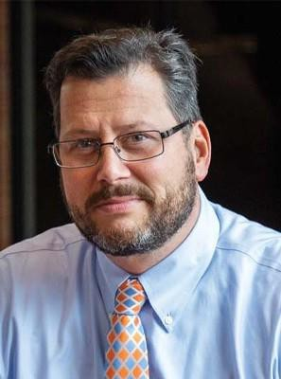
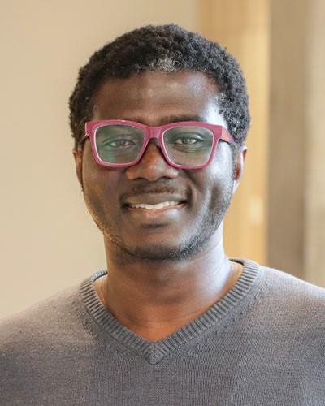
Welcome to the Tickle College of Engineering
Welcome to the University of Tennessee! Now is a great time for our college, and an even better time to be a student. The Engineering Vols community is a place where students feel supported in pursuing their individual passions. Today is only the start of your journey to a superior and meaningful educational experience. Go Vols!
Matthew Mench, Dean
Michael Danquah Associate Dean
for Academic & Student Affairs

Slide 4
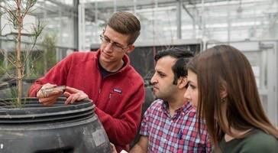

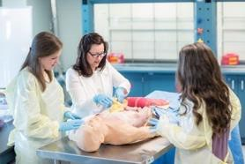
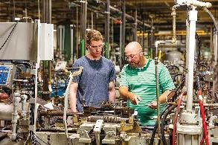
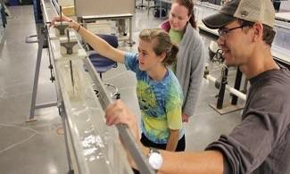
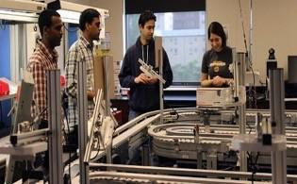


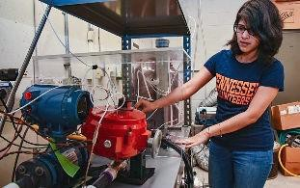

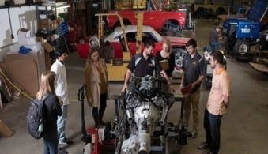
Majors Offered- visit departmental website
to learn all about our majors!
Biomedical Engineering tickle.utk.edu/bme
Biosystems Engineering bess.tennessee.edu
Materials Science and Engineering mse.utk.edu
Civil and Environmental Engineering cee.utk.edu
Industrial and Systems Engineering ise.utk.edu
Applied Engineering tickle.utk.edu/applied
Electrical Engineering and Computer Science eecs.utk.edu
Nuclear Engineering ne.utk.edu
Chemical and Biomolecular Engineering cbe.utk.edu
Mechanical and Aerospace, Engineering
https://tickle.utk.edu/mae

Slide 5
Your Engineering Orientation Advising To-Do List:
Review this PowerPoint and complete the Orientation Modules linked through the Engineering Advising Website.
Know your Prior Learning Credits (AP, IB, Dual Enrollment, etc.). You will provide these to your Orientation Academic Advisor.
Use the Academic Plan form to create a tentative semester plan to share during orientation advising appointment (more information on future slides).
Check your UTK email for information regarding your orientation advising appointment. This will be sent a week prior to your chosen orientation date.
Review requirements for your degree (more information on future slide).

Slide 6
Terms to Know
Pre-requisite – a course that must be completed successfully before enrolling in another course that requires it.
Co-requisite – a course that must be completed before, or taken alongside, a course that requires it.
Credit Hour – a unit of academic credit received for 100 minutes of weekly classroom instruction or two-three hours of laboratory instruction. In general, a large portion of college courses are three credit hours each.
Volunteer Core (Vol Core) – a common set of requirements all students at the university must meet to earn an undergraduate degree. See the Undergraduate Catalog for a full description of these requirements.
□ Course Number – The three-digit number that identifies a specific course, such as 101 in ENGL 101. Courses at 100 and 200 level are best for first year students. Courses at 300 and 400 level are best for upper-class students.

Slide 7
Abbreviations to Know
Engineering Fundamentals (EF)
International Baccalaureate credit
earned from exams (IB)
Grade Point Average (GPA)
FA, SP, SU – refers to semesters when a course is taught (fall, spring, summer)
Advanced Placement credit earned from exams (AP)
Dual Enrollment (DE)—collegecredit earned while in high school
Degree Audit Reporting System (DARS)
Course Registration Number (CRN)

Slide 8
Requirements for Your Degree
Volunteer Core Requirements ( The Upcoming Undergraduate Catalog Year will be available online in early May)
  See ‘terms to know’ on the next screen
  Required by the University of Tennessee for all students
  Review at https://catalog.utk.edu/ and choose ‘Volunteer Core Requirements’ from the navigation bar
Major Requirements ( The Upcoming Undergraduate Catalog Year will be available online in early May)
  Required by your individual engineering major
  Review at https://catalog.utk.edu/. Choose ‘Majors A-Z’ from the navigation bar
  Options for minors exist (and are not required), but this topic is best addressed after you have begun your first semester
All requirements are specific to your catalog year, which is generally the fall catalog for the year you began studying at the University of Tennessee.
Course descriptions can be found on the website listed above, from the same navigation bar. These course descriptions include pre-requisites or co-requisites (see ‘terms to know’ on next screen) for any given course.

Slide 9
Volunteer Core Categories
First Year Composition (FYC) Written Communication ( WC) Oral Communication (OC)
Applied Oral Communication (AOC) Quantitative Reasoning (QR) Natural Sciences (NS)
Global Citizenship United States (GCUS) Global Citizenship International (GCI) Arts & Humanities (AH)
Applied Arts & Humanities (AAH) Social Sciences (SS)
Engaged Inquiries (EI)
Expanded Perspectives (choose from
AH, AAH, GCI, GCUS, or SS)
You can view these categories and the course choices in the Undergraduate Catalog for the upcoming catalog year when it is available in May.
You can also run your DARS report in your MyUTK to view degree requirements during the upcoming fall semester.

Slide 10
Crafting Your Upcoming Academic Plan
You are asked to create a tentative academic plan and share it with your
advisor during orientation advising.
For now, you need only plan out the course names and numbers (for example,
English 101) that you plan to take.
You do NOT need to select the exact section (days of the week/time) of each course for which you plan to register but you can review this via the Plan Ahead function in the registration system found on MyUTK.
You may be bulk loaded into specific courses. You will review this and
update/ register for your courses with your advisor during your
orientation advising appointment.
Courses associated with various honors programs will be addressed during your orientation advising appointment.
The courses that you plan are largely based on the math classes that you are qualified to take, determined by your highest Math ACT/SAT score, Math Placement Exam, or college credits you have already earned.

Slide 11
Crafting Your Upcoming Academic Plan (cont.)
If your highest ACT/SAT math score does not place you into the level of math you had expected, please review your options below:
  AP credits, IB credits, required score on a Statewide Dual Credit Exam, and/or Dual Enrollment credits override the ACT/SAT Math scores. You MUST provide verification of any of these credits, and/or the score/grade earned.
  Successfully pass the online math placement test Level 4 through the math department to demonstrate readiness for Math 141 or Level 3 for Math 131 readiness.

Slide 12
Math Placement Guide:
Course Numbers | Course Description | Credit Hours | Placement Guide
Math 119 | College Algebra (S/NC Grading only) | 3 | Math ACT 24 or lower (SAT Math 580 lower)
Math 131 | Calculus 1A infused with precalculus | 3 | Math ACT Scores of 25, 26, 27 (SAT Math 590 to650)
Math 141 or 147 | Calculus 1 or Honors | 4 | Math ACT 28 or higher (SAT Math 660 to 710) Honors- Math ACT 32 or higher (SAT Math 720 or higher)
Math 142 or 148 | Calculus 2 or Honors | 4 | Credit for Math 141 or 147 (AP, IB, Dual Enrollment)
Math 241 or 247 | Calculus 3 or Honors | 4 | Credit for Math 142 or 148 (AP, IB, Dual Enrollment)
Math 231 or 237 | Differential Equations 1 or Honors | 3 | Credit for Math 142 or 148 (AP, IB, Dual Enrollment)
Math 251 or 257 | Matrix Algebra 1 or Honors | 3 | Credit for Math 142 or 148 (AP, IB, Dual Enrollment)

Slide 13

Tentative* Semester Classes:
Math ACT Scores of 25, 26, 27 (SAT Math 590 to 650)
Course Numbers | Course Description | Credit Hours
English 101/112/131 | English Composition I | 3
Math 131 | Calculus 1A infused with precalculus | 3
Engineering Fundamentals 141 | Introduction to Physics and Modeling for Engineers I | 4
Volunteer Core Course OR Computer Science 101 (for Electrical, Computer, and Computer Science Majors Only) | Choose from Social Science, Arts & Humanities, Global Citizenship-United States, or Global Citizenship- International lists in Undergraduate Catalog (pending any earned college credits) | 3
* advisor and student will review the courses prior to registration |  | Total: setwithadvisor

Slide 14
Tentative* Semester Classes:
Math ACT Scores of 28 or higher (SAT Math > 660)
Course Number | Course Description | Credit Hours
English 101/112/131 | English Composition I | 3
Math 141/147 | Calculus I/Honors | 4
EF 151/157 | Physics for Engineers I/Honors | 4
EF 105** | Computer Methods in Engineering Problem Solving | 1
OR | OR | OR
COSC 101 (for Electrical, Computer Engr. and Computer Science majors only) | Introduction to Programming | 3
Chemistry 122-123/128 (depending on major choice) | General Chemistry I and Lab/ Honors | 4
Engineering Fundamentals 102 or First Year Studies 101 or 129 | Introduction to TCE or The UT Experience or Special Topics Seminar | 1
*advisor and student will review the courses prior to registration |  | Total: set with advisor
**EF105 is a co-req with EF152, which you wouldn’t take until Spring semester, but we recommend if able to that students take it in the Fall semester.

Slide 15
Success Tips for Engineering Majors
Focus on time management and prioritization skills.
Attend class regularly.
Find a productive study location and form study groups.
Keep up with homework daily.
Utilize tutoring and support provided on campus. Go regularly, not just once.
  Engineering Study Center
  Vol Study Center
Introduce yourself to your professors—ask questions about class expectations and requirements.
Connect with your advisor—ask questions and share your plans.

Slide 16
Experience Engineering
There are many ways to begin planning for a deeper level of involvement within the Tickle College of Engineering (TCE) outside the classroom. Consider opportunities such as honors programs, minors, studying abroad, career development, co-op or internships, global initiatives, undergraduate research, and more.
On the next page, read about some of the opportunities available to you and be prepared to begin discussing the ones you are most interested in with your advisor.

Slide 17
Experience Engineering
Center for Career Development & Academic Exploration
Explore majors, develop career readiness,
participate in job fairs
Cook Grand Challenge Engineering Honors Program
Provides greater intellectual challenges and broader educational experiences for engineering students
Dwight Hutchins Expanding Access to Engineering Program
Check out the programs, support services, and
student organizations
Engineering Faculty Led Study Abroad
Study abroad in engineering courses with our faculty
Engineering Student Organizations
Consider joining a student organization in engineering
Engineering Professional Practice (co-ops/internships)
Enhance your classroom learning with real world work experience, participate in hiring expos in Fall and Spring semesters
Innovation & Collaboration Studio
Hands-on maker space to create personal and classroom projects
Office of Undergraduate Research
Attend a “getting started” seminar, connect to
research opportunities
Veteran Student Services
Connects veterans to support services

Slide 18



The advising team looks forward to meeting with you during orientation. Go Vols!
If you have questions about the information in this powerpoint that you feel need to be answered prior to orientation, contact the Engineering Advising office at (865) 974-4008 or by e-mailing engradvising@utk.edu.
Follow us on:
@utk.tce
@UTK_TCE
@utk.tce

